Slide 1
Force and Newton's Laws
Chapter 19
Blue Book

Slide 2
Bell work
Get notebook paper out and label it
“Quarter 1 Assessment Review”
Begin the work on the Dry erase board silently
This will be graded (Like everything we do☺ )!!

Slide 3
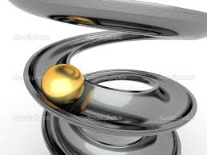
Bell work: Critical thinking Discussion…
Is this ball moving or not moving?
If its not moving, what would have to happen in order to make it move?
If it is moving, will it continue moving forever?
If it stops moving, what would make it stop?

Slide 4
Newton’s first law
A Force is a push or a pull.
Net force: Combines/totals all force acting on an object.

Slide 5
Momentum and Magnitude
Momentum is also defined as the mass of a motion
Momentum = mass • velocity
Magnitude: Is how strong the force is.
Ex: How strong an earthquake is (measured on Richter scale 1-10)

Slide 6
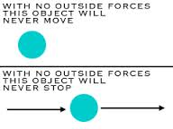
Newton’s First Law
If the net force acting on an object is zero, the object remains at rest, or if the object is already moving, continues to move in a straight line with constant speed.

Slide 7
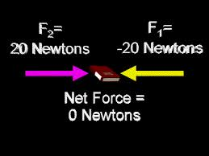
Example
Is this book moving? How do you know?

Slide 8
Newton’s first law
Balanced forces vs. Unbalanced forces:
Balanced forces means the net force is at zero and objects velocity does not change.
Unbalanced forces means that the net force is not zero and the objects velocity does change.

Slide 9
Newton’s first law Lab
Review!! Any questions???
Think of a scenario or skit for Law #1

Slide 10
Critical thinking discussion
In which situation would the sled move quicker in? How do you know?
Why when is it harder to move an object at first? And why does it get easier when its in motion?

Slide 11
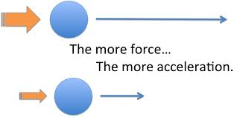
Answer
The sled with the more dogs pulling will go faster because more force causes more acceleration!

Slide 12
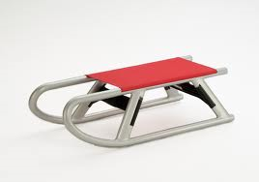
Critical thinking Question
Which sled would be harder to pull? How do you know?

Slide 13
What about now? How do you know?

Slide 14
Friction
Friction: the force that brings nearly everything to a stop. This force is a resistance when sliding.
Three types of friction:
Static: attraction of atoms when objects are not moving (increases with rough or heavy objects)
Sliding: stops a sliding object (Fast stop rate)
Rolling: stops a rolling object (slower stop rate)

Slide 15
Newton’s Second Law
Newton’s second law connects the ideas of force, mass, and acceleration.
Equation:

Slide 16
Newton’s Second law
Gravity
Gravity is constantly pulling you downward. Gravity also causes the Earth to orbit the Sun and the Moon to orbit Earth.
Gravity depends on the mass and distance of objects
The more mass the higher the gravitational pull
The closer distance the higher the gravitational pull

Slide 17
Newton’s Second Law
The Weight of an object is the size of the gravitational force exerted on an object.
On Earth:
Elsewhere: ☺

Slide 18
Newton’s Second Law
Applying Newton’s Second Law:
Think of a skit

Slide 19
Bell work
What is newton's first law
what about newton's second law?

Slide 20
Critical thinking Question
If I hit this nail with the hammer what will happen to the nails position?

Slide 21
Critical thinking Question
If the ball on the left is released what will occur?

Slide 22
Critical thinking Question
How can we describe the scenario below?
How are all three of these scenarios related?
Does this always apply?

Slide 23
Newton’s third Law
Forces always act in equal but opposite pairs. This means that when you push on the wall, the wall pushes on you.
These action and reactions do not cancel each other out! Why? Because they are acting on different objects.

Slide 24
Easy way to remember newtons’ third law

Slide 25
Newton's 3rd law
Think of a skit

Slide 26
Newton’s third law
Weightlessness
We have already discussed weight and what it is on Earth and other places in our universe…
What does it mean to free fall or be weightless? What must occur in order for this to happen?

Slide 27
Match To The three laws!!

Slide 28
Overview of the three laws
http://www.teachertube.com/viewVideo.php?video_id=539
Crash Course : Energy/Newton’s Laws:
https://youtu.be/GqtUWyDR1fg
https://youtu.be/kKKM8Y-u7ds

Slide 29
Newton’s Second law lab
Parachute lab:
We will be making three parachutes and measuring the duration of time it takes for them to hit the floor from the same height.
1st parachute= 1 coffee filter
2nd parachute= 2 coffee filters
3rd parachute= 1 or 2 coffee filters with mass attached

Slide 30
Newton’s Third Law Lab
Mini lab: Measuring force pairs on Page 567

Slide 31
Newton’s third law
Article on page 565
Magazine Exercise

Slide 32
Chapter Overview Lab
Balloon Races: Page 569

Slide 33
Chapter Review
Todays Task:
Chapter review
All three newton laws and related vocabulary

Slide 34
Chapter review sheet Answers
A
I
F
H
B
E
G
C
D
Accelerate
Friction
Static
Sliding
Wheel
Strength
Terminal Velocity
Static
Either push or pull
Friction
Net Force
Motion
Third
Slow down
Balanced
Ex. A person trying to push a massive object.
Friction will never speed up an object because it always acts against the direction of motion.

Slide 35
Force diagrams
Balanced… net force zero
Not in motion
Unbalanced…net force not zero
In motion, moving down or falling

Slide 36
Force diagrams

Slide 37
Force Diagrams
Object slowing down due to friction on ground.
Object is motionless on a surface
Object is suspended from the ceiling
Hot air balloon floating upward

Slide 38
Force Diagrams
A man sliding down a ski slope
A car coasting to the left

